Slide 1
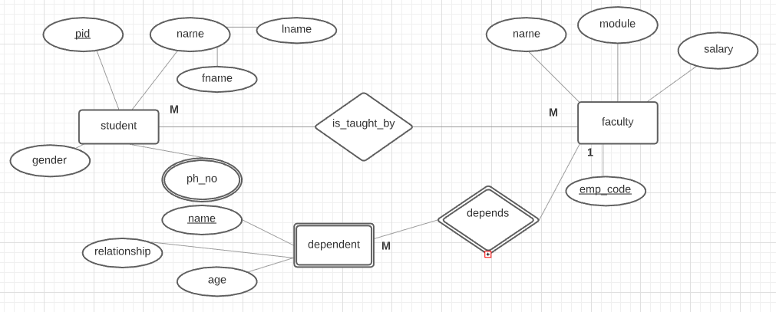
ER Diagram

Slide 2
Few rules
1. Strong entity
include only simple attributes
2. Weak entity
simple attributes of the weak entity + add primary key of associated strong entity
3. 1: M relationship
add primary key of “1” side as foreign key in the “M” side
4. M:M relationship
create table for the relationship and add primary keys of the “M” sides
5. Multivalued attribute
create separate table for the multivalued attribute and add as primary key of the strong entity.

Slide 3
Student
pid | fname | lname | gender
student_phno
pid | ph_no
Faculty
emp_code | name | salary | module
Dependent
emp_code | name | relationship | age
is_taught_by
pid | emp_code

